Slide 1
CMSC 304
Compilation, Interpretation, & Programming Paradigms
Claire Sparks

Slide 2
The von Neumann Architecture
In 1945, von Neumann wrote First Draft of a Report on the EDVAC
  majorly influential
The First Draft contained the first published description of a “stored-program” digital computer
In a stored-program architecture, computers are permanently hardwired with a small set of general purpose operations
A computer is programmed by storing a set of these operations (a program) in memory, and executing the operations sequentially
This stored-program concept became known as the von Neumann architecture
Notes:
Before the von Neumann Architecture, to program a computer would require to physically rewire the machine!! Being able to re-program a computer by changing the contents of memory is immensely easier than re-wiring the thing!

Slide 3
Programming History
The earliest digital computers (such as the EDVAC) were physically massive, had an insatiable need for electricity, and eye-poppingly expensive
Early programmers believed the computer’s time was more valuable than theirs and as a result would program in machine language
Machine language is the sequence of bits that represents an operation, causing the computer to add, compare, move data, etc.
3000
2036
903F
2435
1002
2231
1401
042D
242D
5020
103E
1002
0A04
B42A
2029
1021
3027
56E0
16E2
2422
92FF
1261
1481
0802
0418
0FFC
201B
54A0
5920
193E
1004
0C02
14A1
0FFC
1020
0801
14A1
1042
0802
16E1
0FEA
200C
B00D
1021
3009
200A
1021
3008
0FD0
2004
1021
3002
0FCC
F025
0002
5000
5000
0033
Generating the 50 First Primes in LC-3 Machine Language

Slide 4
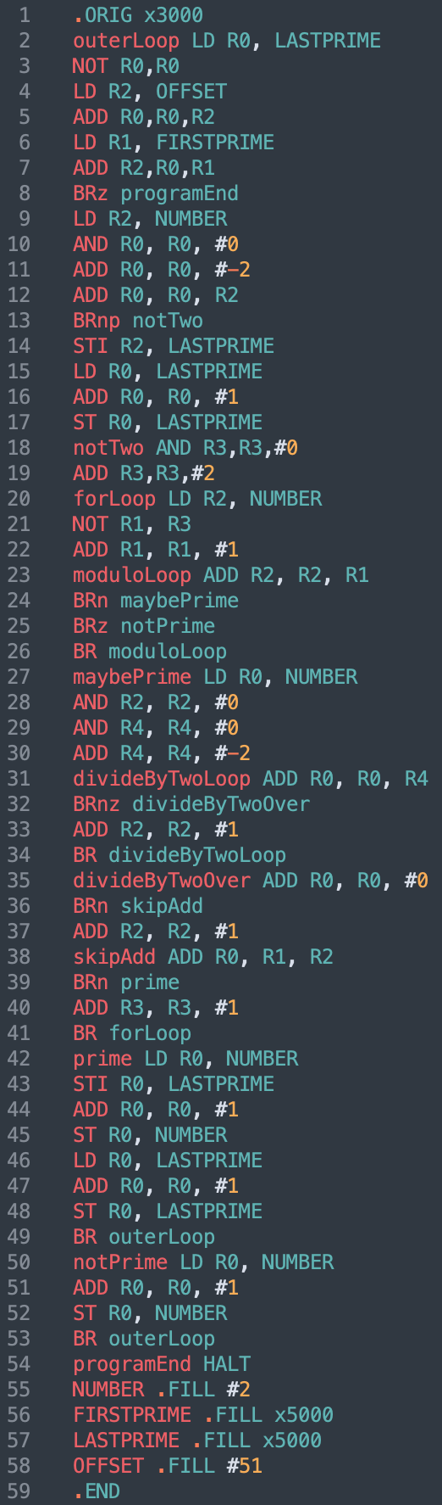
Programming History
Writing programs in machine language is an enormously tedious and error prone task
Assembly languages were invented to allow computer processor operations to be expressed with mnemonic abbreviations
Assembly languages are designed with a one-to-one correspondence between mnemonics and machine language instructions
Assembler: program which translates from mnemonics to machine language
Generating the 50 First Primes in LC-3 Assembly Language
Notes:
*Technically modern assembly languages have more features such as macro support, but the general principle of CPU instructions having a one-to-one correspondence with mnemonic assembly instructions is unchanged
If I had to program in either machine language or assembly language, I’d really prefer assembly

Slide 5
Programming History
A major disadvantage of machine language / assembly is it’s machine dependent
Different computers may have different processor operations
  Machine language which is understood by one computer may not be understood by others!
It became increasingly frustrating to have to rewrite programs for every new computer
It also became increasingly difficult for human beings to keep track of the wealth of detail in large assembly language programs
What’s the solution?
  Abstraction & High Level Languages!
Notes:
*This is much less of a problem now due to the massive proliferation of x86, but in early computing almost every machine had a different architecture

Slide 6
High Level Languages
Abstraction: a technique for establishing a simpler way to interact with a system, removing the details that are unnecessary to interact effectively with that system
It allows us to not get bogged down in the detail when everything about the detail is working just fine
High Level Language: a programming language where the details of the underlying computer hardware are abstracted away
  Some high level languages abstract away more than others
  All high level languages remove the need to write machine code
Allows for programmers to focus more on the logic of a program and less on the hardware it runs on
Notes:
Talk about abstraction as providing a simplified interface to interact with a complex system. because the underlying system isn't any less complex!

Slide 7
High Level Languages
But if a high level language is abstracted away from the underlying computer hardware, how does the computer know what to do?
High level languages must be translated into machine language!
Compiler: a program which translates a high-level language to machine language
Compilers are substantially more complicated than assemblers
  The one-to-one correspondence between source and target instructions no longer exists
Due to increases in hardware complexity and continuing improvements in compiler technology, a compiler will usually generate better machine code than a human being will

Slide 8
Translation Methods
Compilation
  Programs are translated into machine language before execution
  Compilation generally leads to better performance.
    A decision made at compile time is a decision that does not need to be made at run time
Interpretation
  Programs are translated into machine language at runtime
  The interpreter reads statements in that language more or less one at a time, executing them as it goes along
Languages do not have a specific implementation
Translator: A generic term which can refer to a compiler, interpreter, or assembler
  Anything that converts code from one language into another
Notes:
Technically translators includes assemblers but that’s more in the weeds then we need to get right now

Slide 9
Compilation
Translate high-level language into machine language
Slow translation, fast execution
Compilation process has several phases:
  lexical analysis: converts characters in the source program into lexical units
  syntax analysis: transforms lexical units into parse trees which represent the syntactic structure of program
  Semantics analysis: generate intermediate code
  code generation: machine code is generated

Slide 10
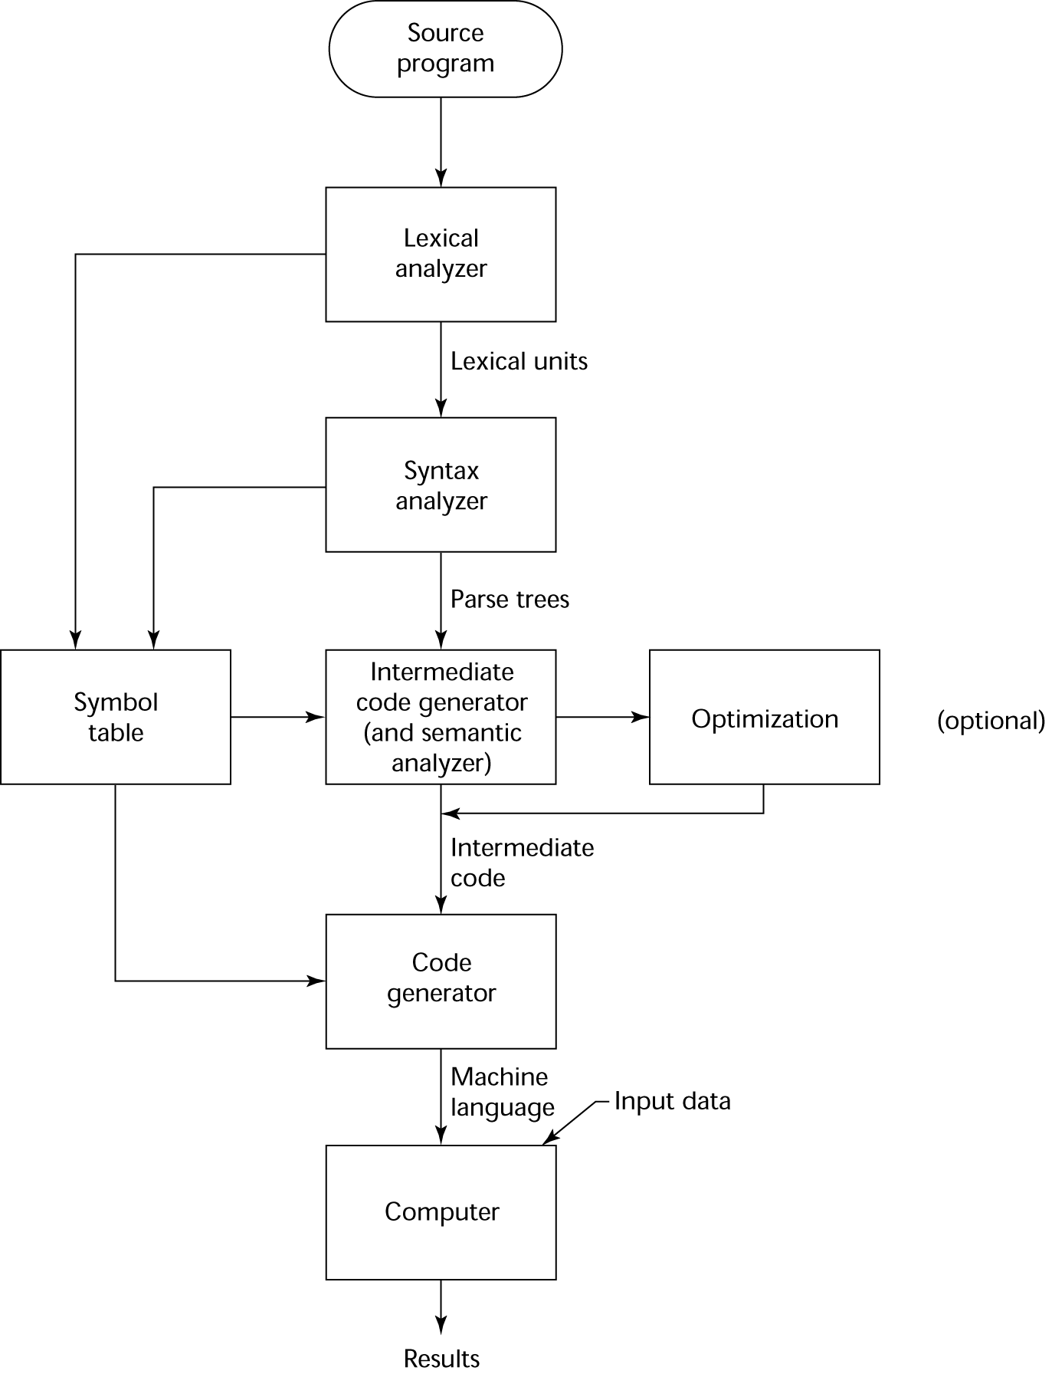
The Compilation Process

Slide 11
Pure Interpretation
In general, interpretation leads to greater flexibility and better diagnostics than does compilation
Because the source code is being executed directly, the interpreter can include an excellent source-level debugger
Easier to implement an interpreter rather than a compiler
Slower execution (10 to 100 times slower than compiled programs)
Often requires more memory
Pure interpretation is now rare for traditional high-level languages
Notes:
Note that the rapid advance in computer hardware changed the goals / priorities of programming languages

Slide 12
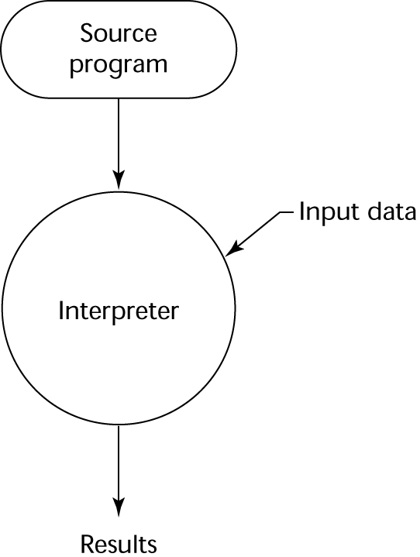
Pure Interpretation Process

Slide 13
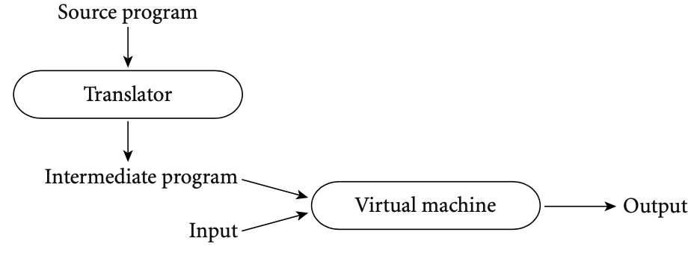
Hybrid Implementation Systems
A compromise between compilers and pure interpreters
While the conceptual difference between compilation and interpretation is clear, most language implementations include a mixture of both

Slide 14
Hybrid Implementation Systems
We say that a language is compiled if the translator analyzes it thoroughly and if the intermediate program does not bear a strong resemblance to the source
These two characteristics—thorough analysis and nontrivial transformation—are the hallmarks of compilation

Slide 15
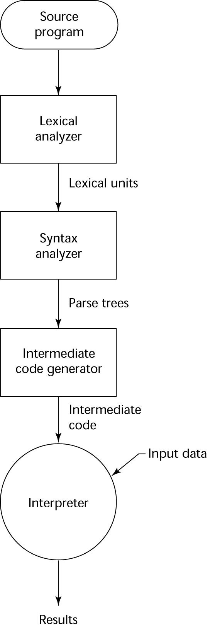
Hybrid Implementation Process

Slide 16
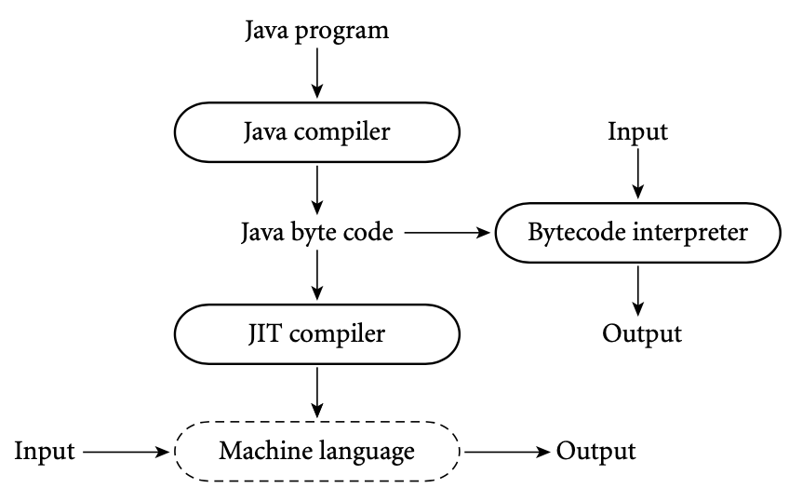
Java
The Java language definition defines a machine-independent intermediate form known as Java bytecode
The first Java implementations were based on byte-code interpreters
Modern implementations obtain significantly better performance with a just-in-time compiler
It translates bytecode into machine language immediately before each execution of the program

Slide 17
Just-in-Time Implementation Systems
Initially translate programs to an intermediate language
Then compile the intermediate language of the subprograms into machine code when they are called
Machine code version is kept for subsequent calls
In essence, JIT systems are delayed compilers

Slide 18
Computational Paradigms
Programming paradigms: patterns / models used to conceptualize the structure and implementation of programming languages
  Similar to biology, these paradigms are an attempt to classify existing programming languages
The most common programming language paradigm is the imperative paradigm
Imperative language: A programming language characterized by:
  The sequential execution of instructions
  The use of variables representing memory locations
  The use of assignment to change the values of variables
Note the similarities to the von Neumann Architecture!

Slide 19
Computational Paradigms
High level programming languages are often designed to abstract away the operations of a computer
The von Neumann Architecture was used almost universally since the very beginnings of digital computing
Consequently, most programming languages today are imperative
But imperative languages represent only a single programming language paradigm

Slide 20
Computational Paradigms
Other paradigms include:
Functional: Treats programs as functions, treats functions as data, and avoids mutable data
Logic: based on formal symbolic logic
Scripting: Emphasize coordinating or “gluing together” components from some surrounding context
Object Oriented: Allows programmers to write reusable code
Not all of these paradigms are mutually exclusive
  Programmers tend to build first and name second, so terminology gets messy!
Notes:
Among others which we won’t mention here

Slide 21
Computational Paradigms
Object Oriented languages have acquired enormous importance over the past 25 years
  Java and C++, both Object Oriented languages, are two of the most popular languages in the world
The object orientated paradigm is an extension of the imperative paradigm
  It relies primarily on the same sequential execution with a changing set of memory locations
The object orientated paradigm has essentially become a new standard
Still encounter the same issues as imperative languages

